Slide 1
Smart Vision: Assistive Device for the Visually Impaired Community Online
Hasventhran Baskaran, Rachel Lum Mei Leng, Fiza Abdul Rahim, Mohd Ezanee Rusli

Slide 2
Link to Paper: https://ieeexplore.ieee.org/document/8821635
DOI: 10.1109/CCOMS.2019.8821635
Published : 23rd February 2019
Presented By:
Ishrat Jahan Ananya | 1631636042
Shadab Hafiz Chowdhury | 1631335642
Sarah Suad | 1632282642
Nabiul Hoque Khandakar | 1631164642

Slide 3
Introduction
Visual impairment creates dependence on others for navigation and object locations.
The visually impaired community face several difficulties in their daily life. With the increase of commercial assistive devices, it can greatly improve their lives, especially for navigation and orientation, which are their main obstacles.

Slide 4
Background
Technology for the disabled has made various advances over the current years.
However, most of these solutions come with a high price that the visually impaired people cannot afford.
By imposing hefty prices on new assistive device for visually impaired, it is not going to reach the targeted user nor fulfilling the functions of the device.

Slide 5
PROPOSED Solution
Investigate the potential of computer vision services to allow visually impaired and blind users aware what is happening around them.
A prototype called Smart Vision is developed to tackle this problem. The prototype aims to bring the beautiful world as a narrative to the visually impaired and blind users.
The narrative is generated by converting the scenes in front of them to text which describes the important objects in the scene.
Examples of text include “a group of kids playing”, “a man posing for a picture” or “a bird sitting on tree branch”. One line along with some keywords are narrated as an audio to the users

Slide 6

Methodology

Slide 7
Components
Raspberry PI 3 Model B: This small single-board computers is appended with Pi Camera, which have 5 Megapixels and can record video with a high definition quality of 1080P. A button embedded on a breadboard is connected to the Raspberry Pi.
Microsoft Cognitive Service: The API used for this project is the cloud-based Computer Vision API, which gives developers access to cutting edge algorithms for handling pictures and returning information. By uploading an image, the system returns the information by reading out the visual contents found in that image to the user.

Slide 8
Components (Continued)
Google Text to Speech (gTTS): It is a Python interface to Google’s Text to Speech API. Create an mp3 file with the gTTS module or gtts-cli command line utility. It allows for unlimited lengths of spoken text by tokenizing long sentences where the speech would naturally pause.
Python: The programming language being used to stitch the devices together and to automate small tasks on systems

Slide 9
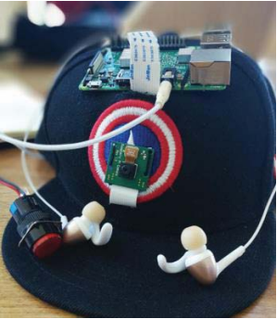
Prototype

Slide 10
FUTURE WORK AND CONSTRAINTS
Engineer a better housing for the hardware components
Add support for other languages to the text-to-speech software to cater for native speakers
Onboard obstacle detection and hazard detection and give out response
Come up with a solution for internet connectivity, right now operating with WiFi reception from a mobile hotspot

Slide 11
THANK YOU

